Slide 1
Budweiser Growth Opportunities
10/23/2020
Alex Gilbert
Yves Hughes

Slide 2

Purpose
To present findings of our exploratory analysis of the data provided by Budweiser
Express market trends
Offer suggestions for growth opportunities
Notes:
.

Slide 3
The Data
Total of 2410 beers in the combined data
Of that, 1,005 beers have no IBU value provided
There were also 62 beers with no ABV or IBU provided
We several approaches:
Omit missing data altogether
Use a model to predict missing values
Use median IBU values for future analyes

Slide 4
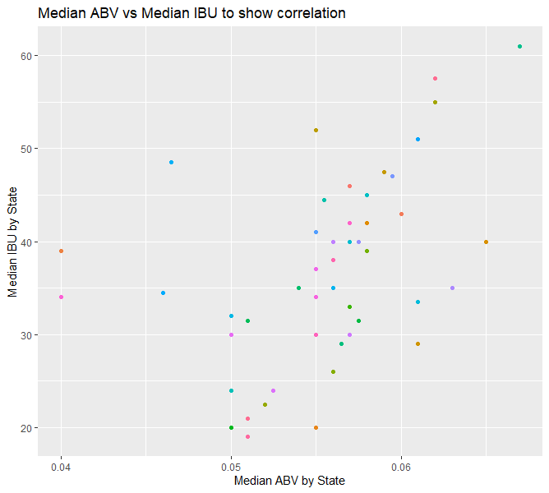
Comparing Median ABV and IBU

Slide 5
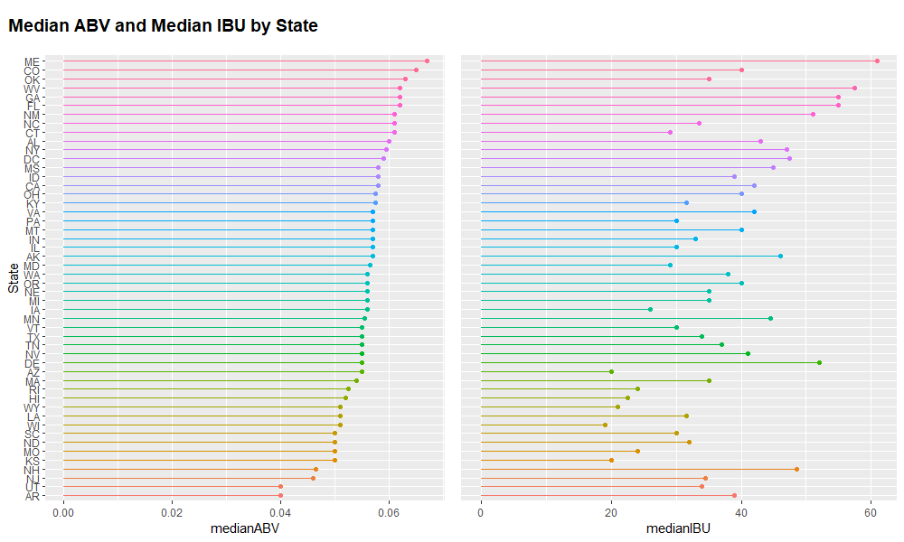
Comparing Median ABV and IBU

Slide 6
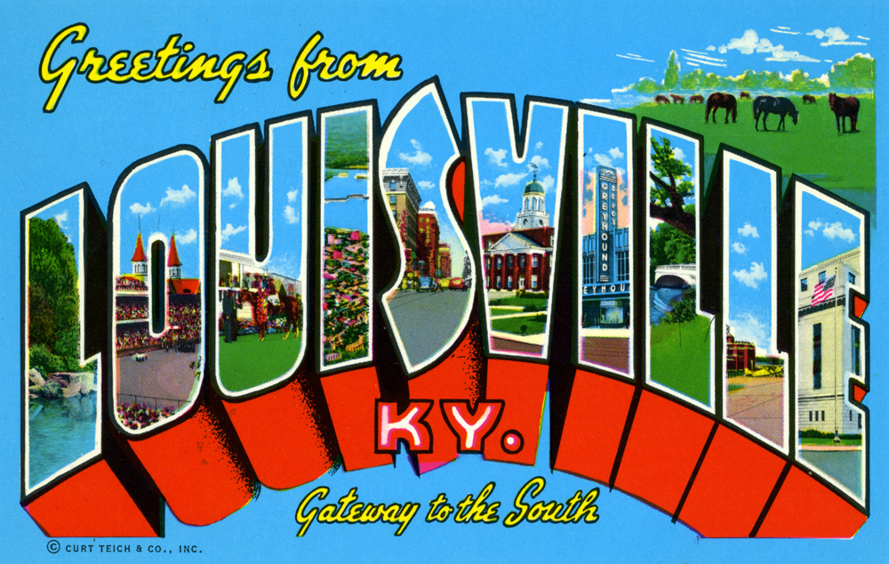
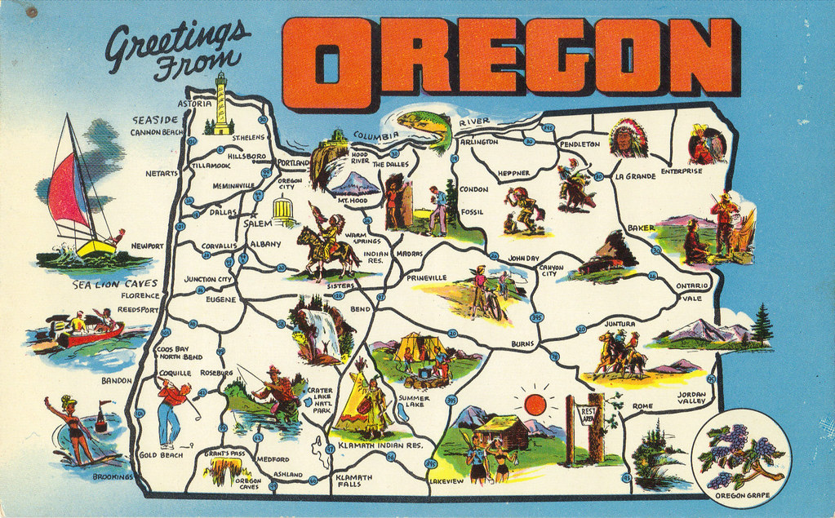
Highest ABV & Bitterness (IBU)
Highest ABV: 12.5% - London Balling By: Against the Grain Brewery
From: Louisville,KY
Highest IBU: 138 - Bitter Bitch Imperial IPA By: Astoria Brewing Company
From: Astoria, OR

Slide 7
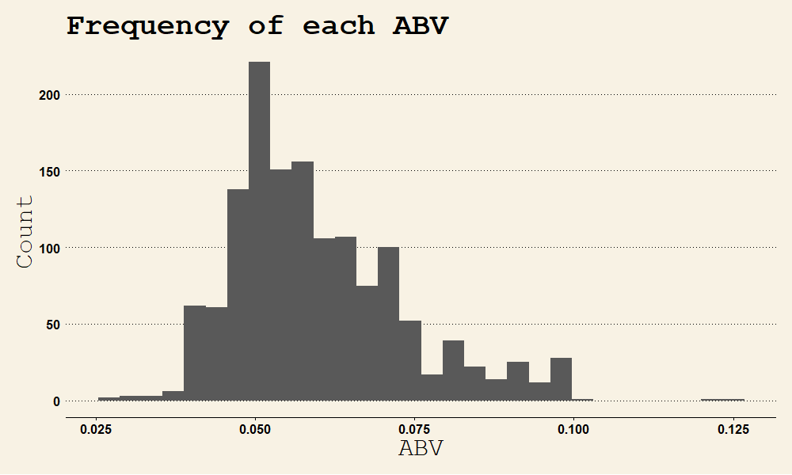
Market Analysis of ABV

Slide 8
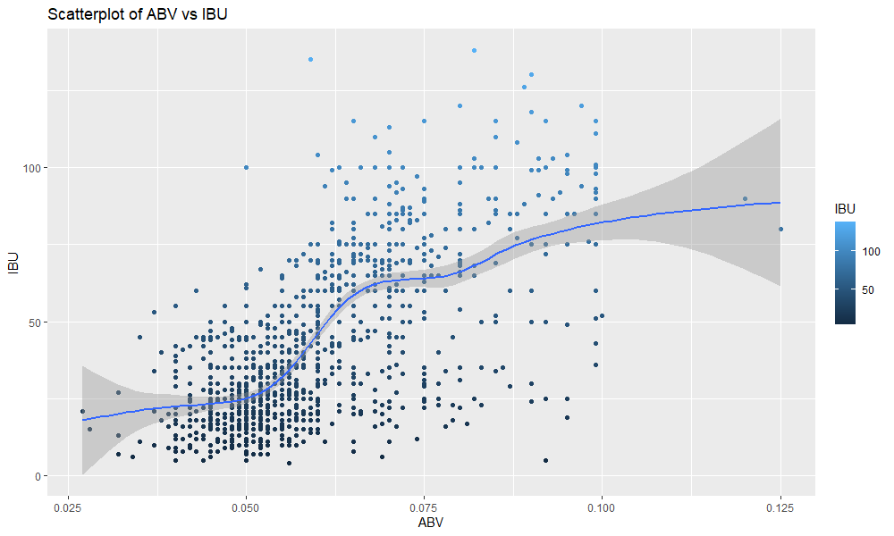
Bitterness related to ABV

Slide 9
Classifying Ales and IPAs
Used KNN to create an algorithm for classifying beers by comparing ABV and IBU
Accuracy = 84%
Correctly identifies Ales 86.6% of the time
Correctly identifies IPAs 81.1% of the time

Slide 10
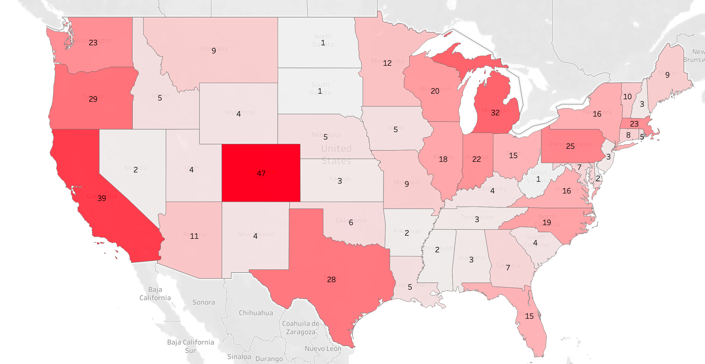
Opportunities for Investment

Slide 11
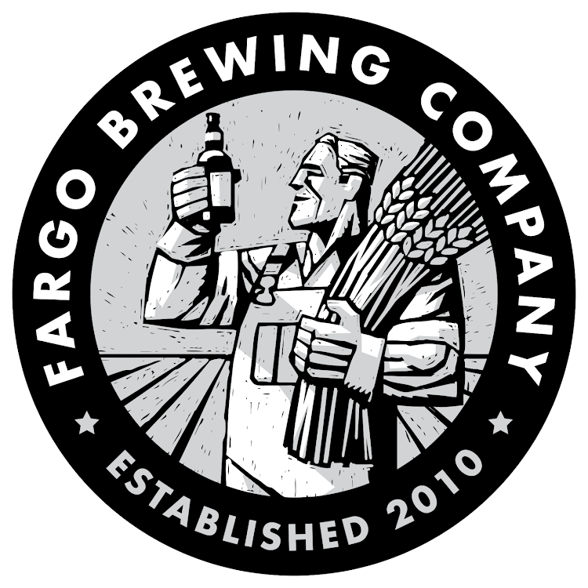
Recommended Acquisition
​Sole brewery of ND producing only 3 popular styles of beer​
Increase variety to the region​
​
Bring distribution to CO & CA​

Slide 12
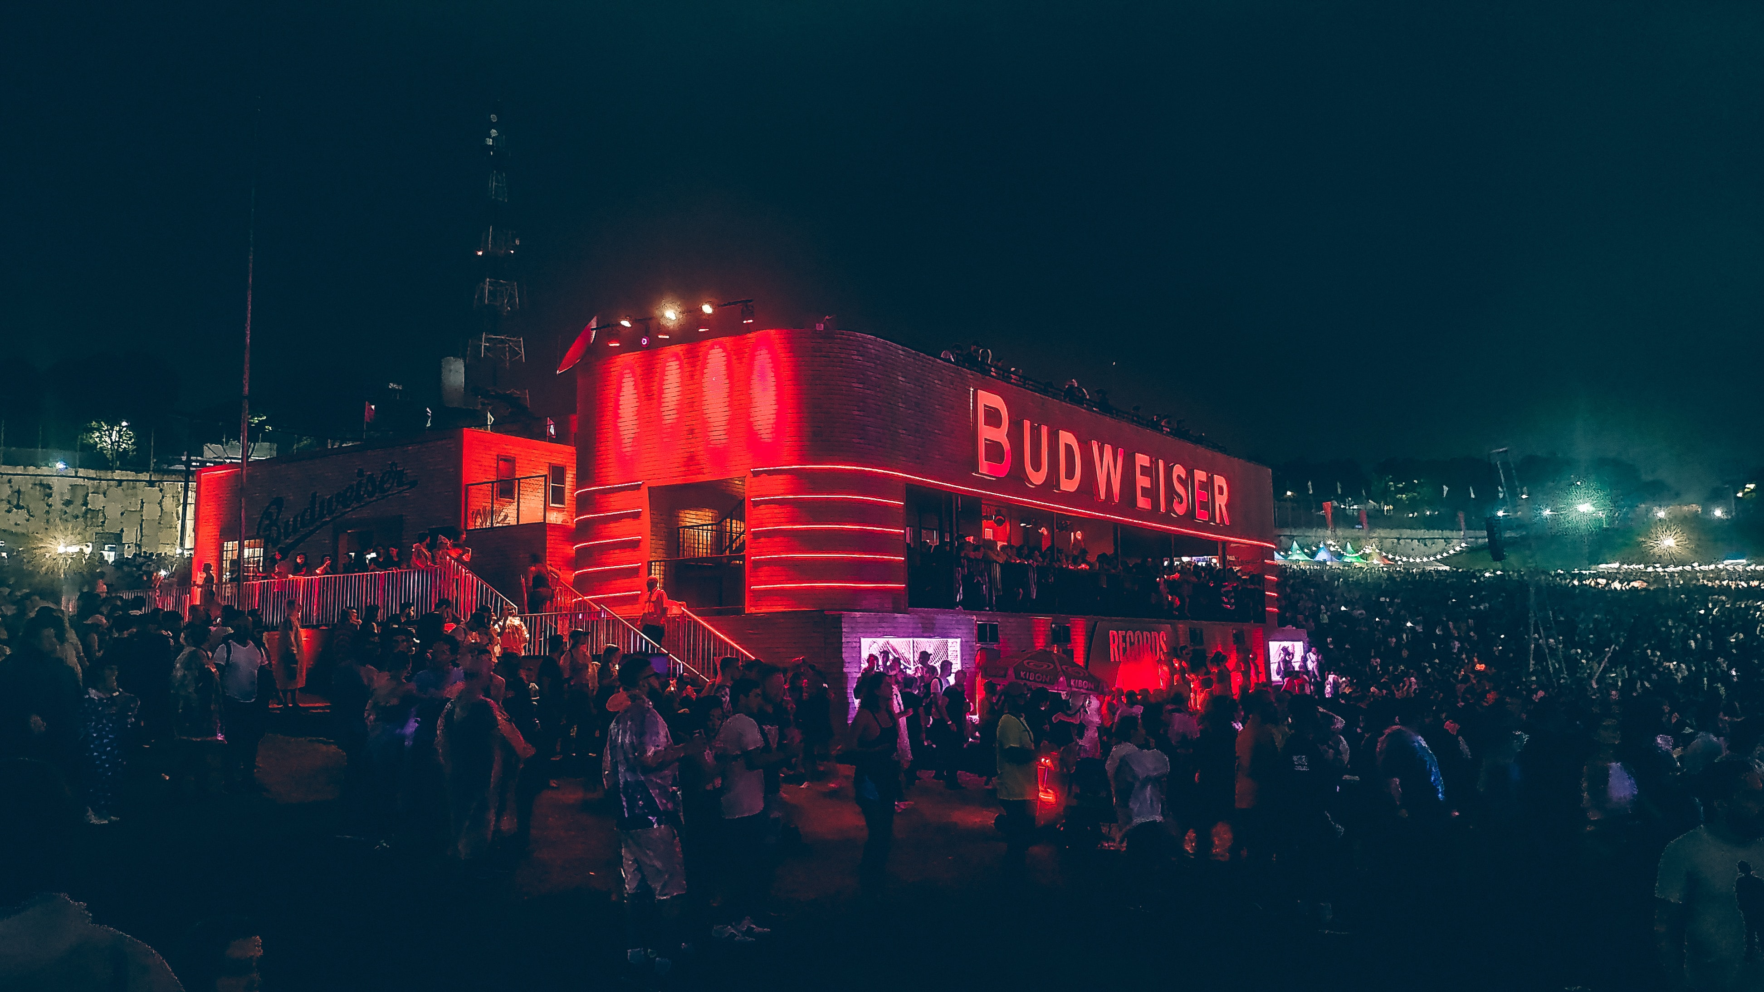
Thank You

